Slide 1
IBM University Engagement Project Submission
“Exploring the Power of Machine Learning with IBM Cloud”

Slide 2

Project Tile – Rural Infrastructure Project Classification Using Machine Learning
Domain of Project – Rural Development / Infrastructure
Student Name | Recent Passport Photo | Email ID | Mobile number [WhatsApp]
Vinayaga Sundari P |  | vinayagasundari26@gmail.com | 9360223945

Slide 3
Problem Statement
Problem Statement: Rural Infrastructure Project Classification Using Machine Learning
Rural infrastructure development plays a vital role in improving transportation, education, healthcare, and economic growth. Government projects are implemented under different PMGSY (Pradhan Mantri Gram Sadak Yojana) schemes based on project characteristics. Manually classifying these infrastructure projects is time-consuming and prone to errors.This project aims to develop a Machine Learning model that automatically classifies rural infrastructure projects into the appropriate PMGSY category using historical project data. The solution helps improve decision-making, reduces manual effort, and supports efficient project management.
Dataset link : https://aikosh.indiaai.gov.in/web/datasets/details/pradhan_mantri_gram_sadak_y ojna_pmgsy.html

Slide 4
Proposed Solution - IBM watsonx.ai Studio – AutoAI
This project uses IBM watsonx.ai Studio AutoAI to automate the classification of rural infrastructure projects.
The solution performs:
Data preprocessing
Automatic feature engineering
Machine Learning model selection
Hyperparameter optimization
Model evaluation
The trained model predicts the correct PMGSY project category with high accuracy, enabling faster and more reliable classification.

Slide 5
Technology Used
Platform
IBM Cloud
IBM watsonx.ai Studio
IBM AutoAI
Programming Language
Python
Machine Learning Type
Classification
Algorithm Used
Snap Random Forest Classifier
XGBoost Classifier

Slide 6
Technology Used
Dataset - PMGSY_DATASET.csv https://aikosh.indiaai.gov.in/web/datasets/details/pradhan_mantri_gram_sadak_y ojna_pmgsy.html
Accuracy Obtained :
The Snap Random Forest Classifier was selected as the best model with an accuracy of 92.4%.
Hyperparameter Tuning :
Automatically optimized using IBM AutoAI

Slide 7
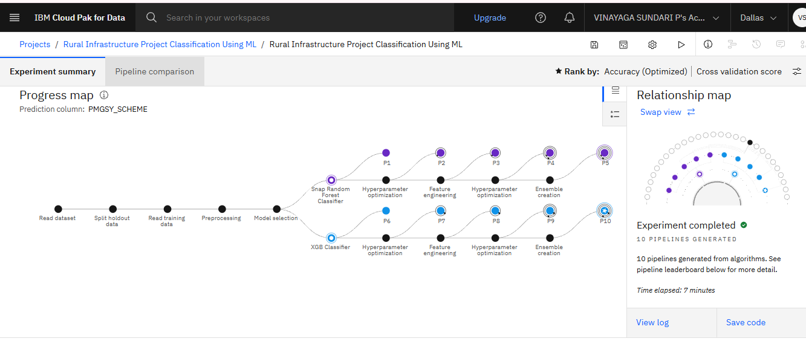
Training Screenshots-

Slide 8
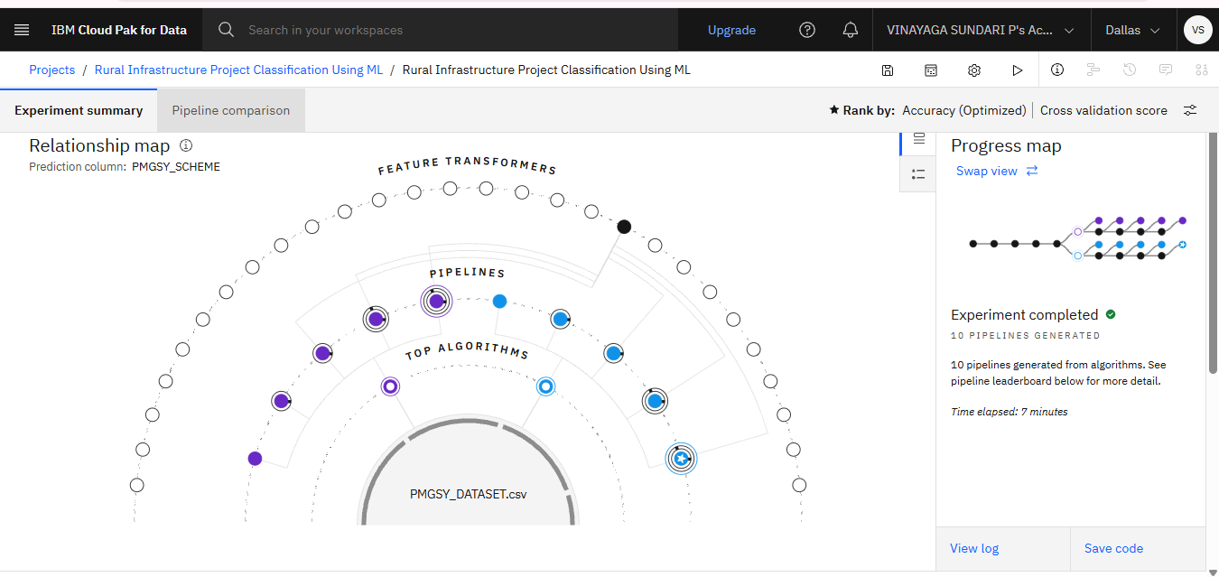
Training Screenshots-

Slide 9
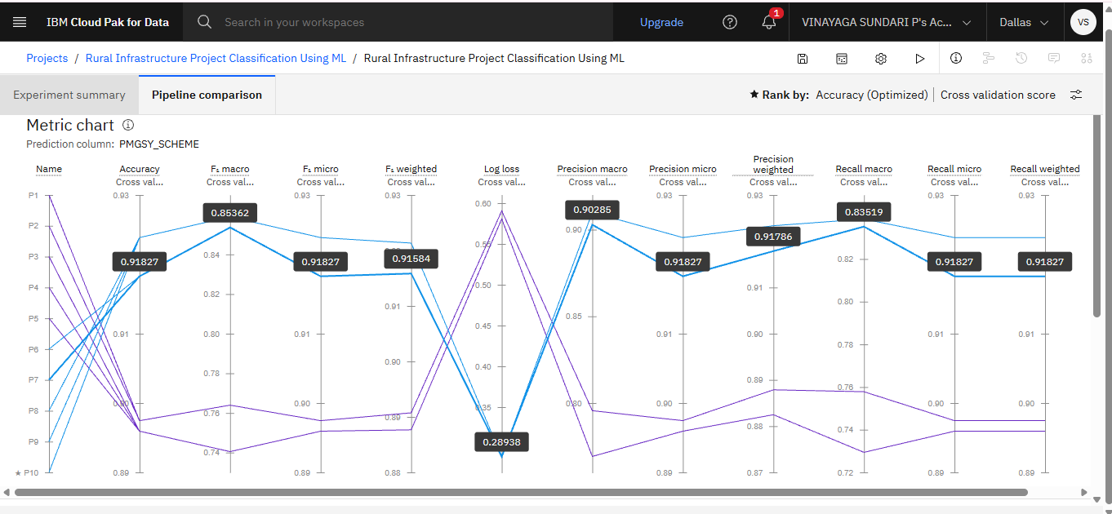
Training Screenshots-

Slide 10
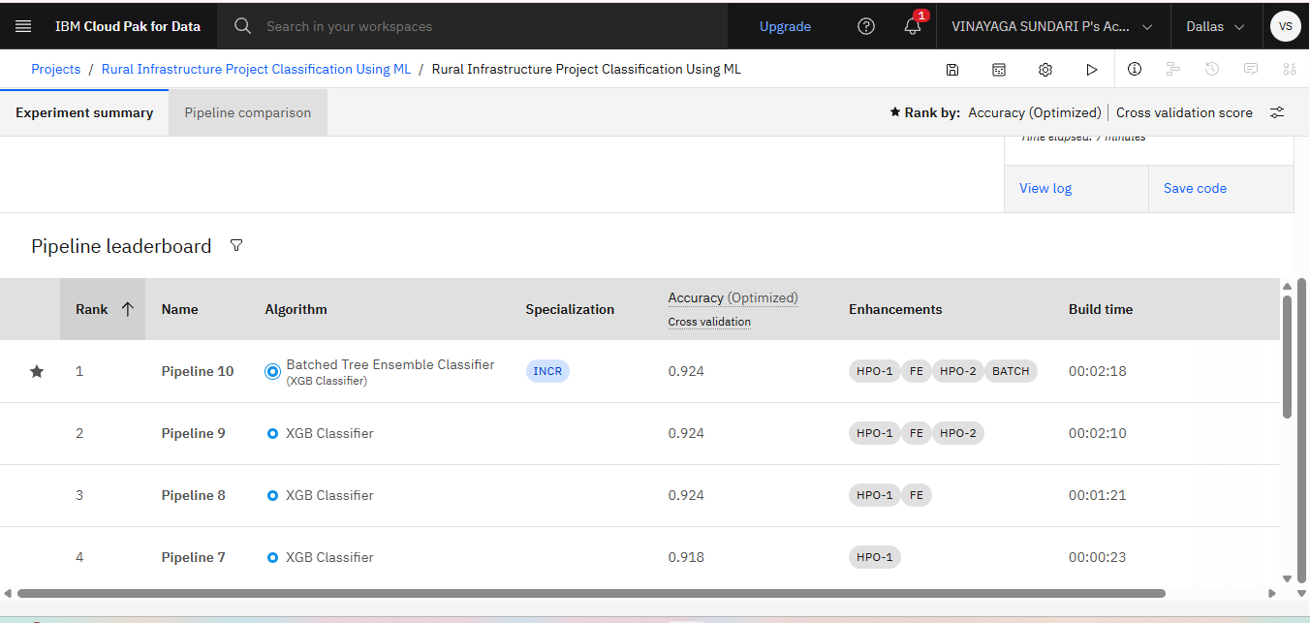
Best Model Screenshot:

Slide 11
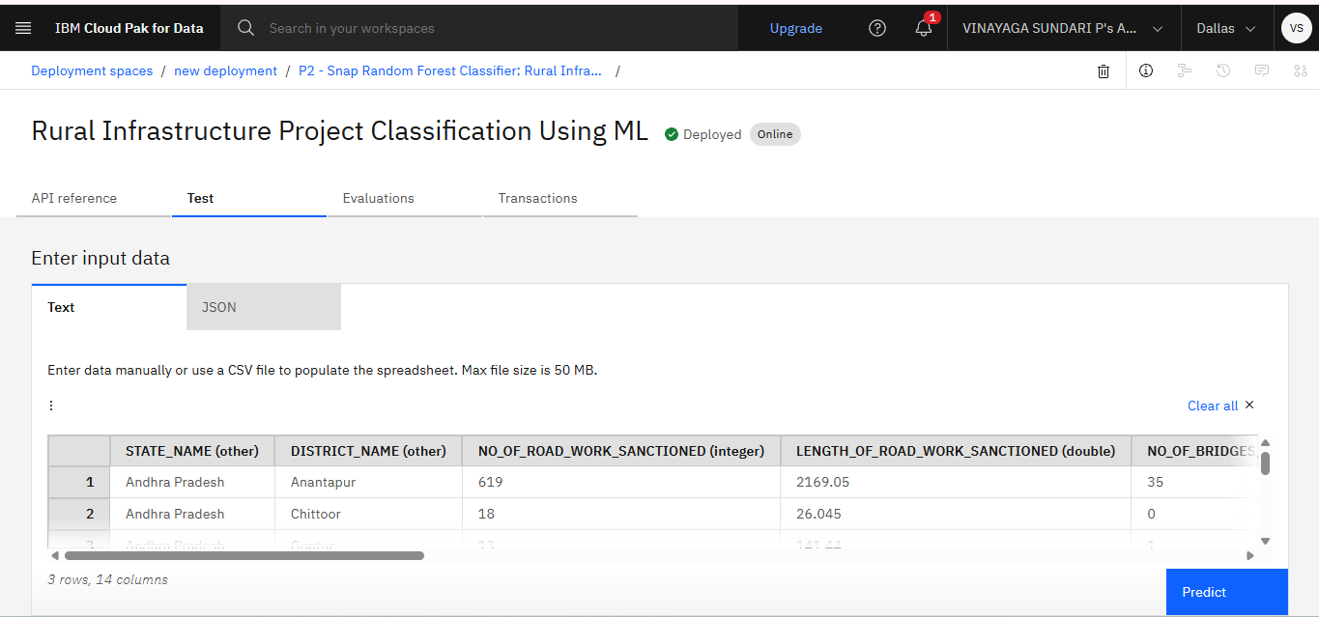
Testing Screenshot:

Slide 12
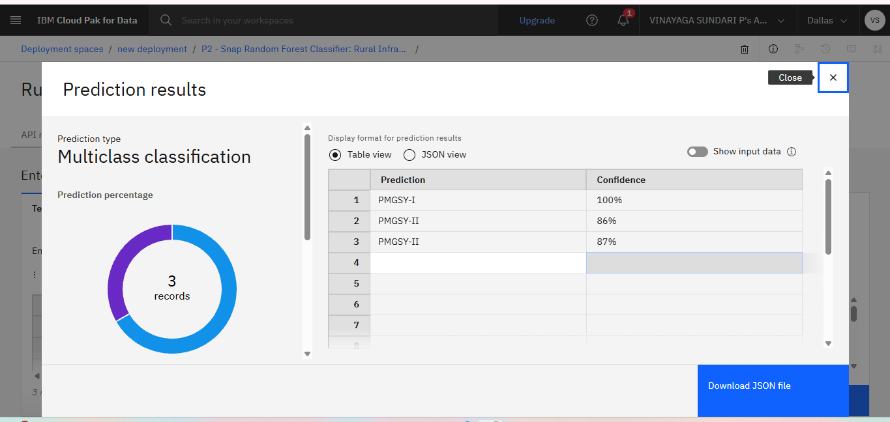
Testing Screenshot:

Slide 13
Novelty and Uniqueness
Automates rural infrastructure project classification.
Reduces manual classification errors.
Uses IBM AutoAI for automatic model generation.
Provides fast and accurate predictions.
Supports government planning and rural development initiatives.
Easily scalable for larger infrastructure datasets.

Slide 14
Git Hub Link
A public GitHub repository was created to host the IBM Machine Learning project. The repository includes all the required project files, such as the dataset, problem statement, project presentation, Python notebook, and README documentation.
GitHub Repository Link:
https://github.com/Vinayaga2605/IBM-Machine-Learning-Project
Uploaded Files:
PMGSY_DATASET.csv
ProblemStatement.pdf
ProjectPresentation.pptx
Rural Infrastructure Project Classification Using ML.ipynb
README.md
·
·
·

Slide 15
Future Scope
Improve prediction accuracy using larger datasets.
Integrate GIS and satellite data for infrastructure planning.
Develop a web application for real-time project classification.
Deploy the model as a cloud-based API using IBM Cloud.
Extend the solution to classify additional government infrastructure schemes.
·
·
·

Slide 16

Certificates Earned:
Please add your credly certificate

Slide 17
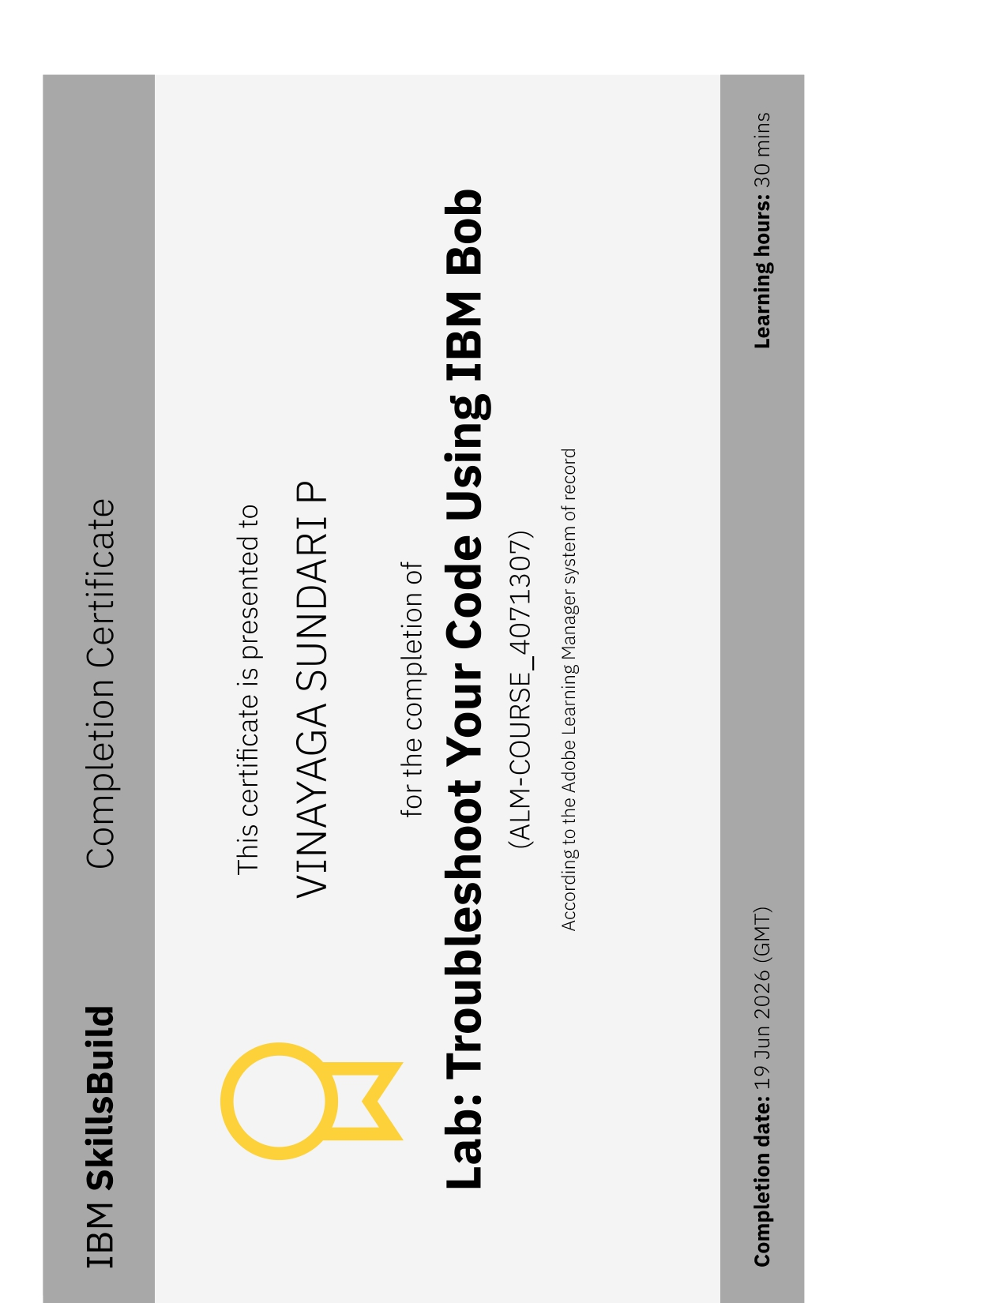
Certificates Earned:​
Add your IBM BOB Certificate

Slide 18


